Slide 1
Computer Graphics Hardware
Video Display Devices

Slide 2
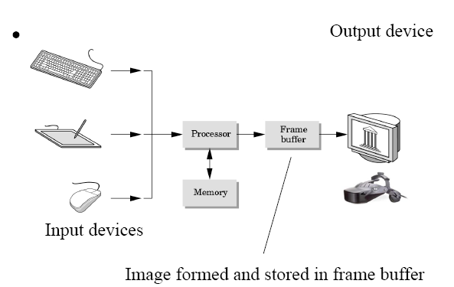
Overview of a graphics system

Slide 3
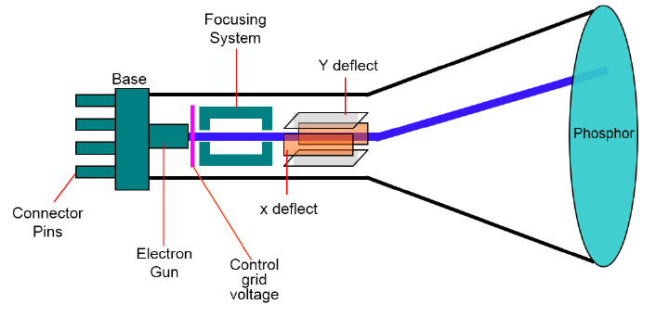
Cathode-ray-tube (CRT)

Slide 4
Cathode-ray-tube (CRT)
The primary output device in a graphical system is the video monitor. The main element of a video monitor is the Cathode Ray Tube (CRT), shown in the following illustration.
The operation of CRT is very simple:
1. The electron gun emits a beam of electrons (cathode rays).
2. The electron beam passes through focusing and deflection systems that direct it towards specified positions on the phosphor-coated screen.

Slide 5
Cathode-ray-tube (CRT)
3. When the beam hits the screen, the phosphor emits a small spot of light at each position contacted by the electron beam.
4. It redraws the picture by directing the electron beam back over the same screen points quickly.

Slide 6
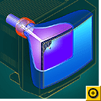
CRT
The screen output is stored in the frame buffer and is converted into voltages across the reflection plates via a digital-to-analog converter (DAG)
Light is emitted when electrons hit phosphor
(the screen is phosphor coated)
But light output from the phosphor decays
exponentially with time, typically in 10 – 60
microseconds

Slide 7
CRT (cont.)
Thus the screen needs to be redrawn or refreshed
Refresh rate is typically 60 Hz (1 Hz = 1 refresh per second) to avoid flicker (“twinkling”)
Flicker: when the eye can no longer integrate individual light pulses from a point on screen, e.g., due to low refresh rate

Slide 8
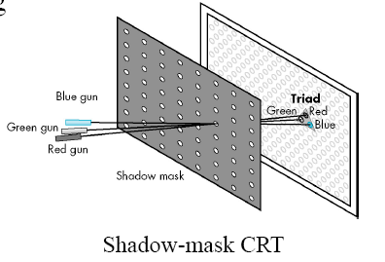
Shadow-mask color CRTs
Three different colored phosphors (R, G, B)
dots are arranged in very small groups (triads) on coating
We see a mixture of three colors
Three electron guns (R, G,B)
emit electron beams in a
controlled fashion so that
only phosphors of the
proper colors are excited

Slide 9
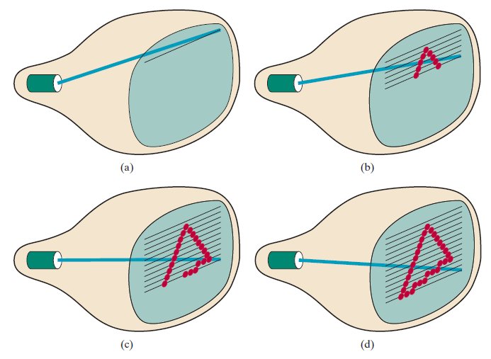
Raster – Scan Display

Slide 10
The Frame Buffer
The image is stored in a frame buffer or refresh buffer containing the total screen area, where each memory location corresponds to a pixel
Stores per-pixel information
– Depth of a frame buffer: number of bits per pixel
– E.g. for color representation, 1 bit => 2 colors,
8 bits => 256 colors,
24 bits => true color (16 million colors)
Color buffer is only one of many buffers, other information, e.g., depth, can also be used
Implemented with special type of memory in standard PCs or on a graphics card for fast redisplay
Part of standard memory in earlier systems

Slide 11
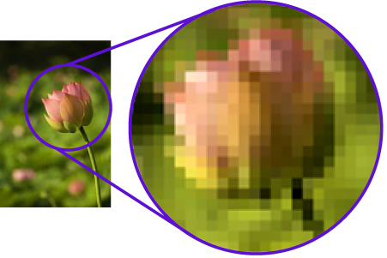
Raster-scan basics
The screen is a rectangular array of picture elements, or pixels
Resolution:
determines the details you can see
number of pixels in an image,
e.g.,
1024×768, 1280x1024, 1366 x 768, etc.

Slide 12
Raster-Scan Pattern
Refresh rate: 24 is a minimum to avoid flicker, corresponding to 24 Hz
Current raster-scan displays have a refresh rate of at least 60 frames (60 Hz) per second, up to 120 (120 Hz).
Refresh procedure:
Horizontal retrace – beam returns to left of screen
Vertical retrace – beam returns to top left corner of screen
Interlaced refresh – display first even-numbered lines, then odd-numbered lines permits to see the image in half the time useful for slow refresh rates (30 Hz shows as 60 Hz).

Slide 13
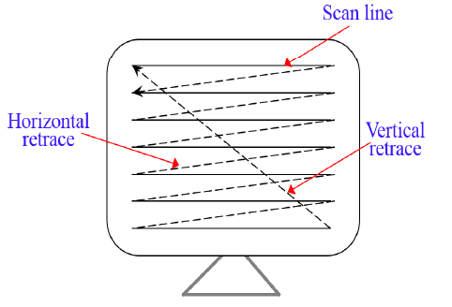
Raster-Scan Pattern

Slide 14
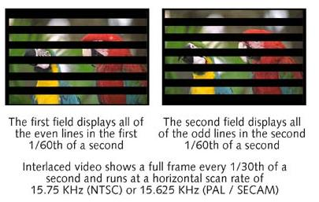
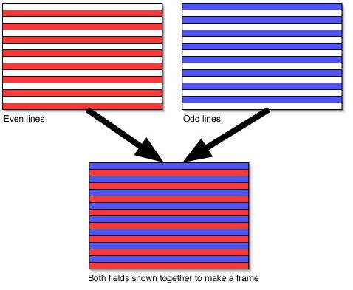
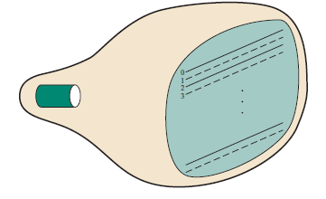
Interlaced refresh

Slide 15
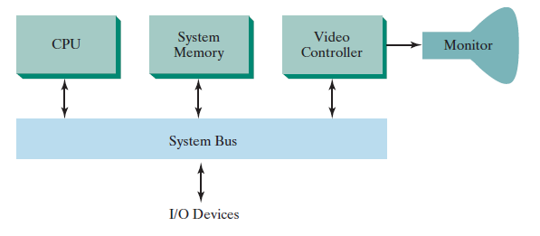
Raster-Scan Systems
Simple raster-graphics system
Video controller (display processor) controls operations of display device.

Slide 16
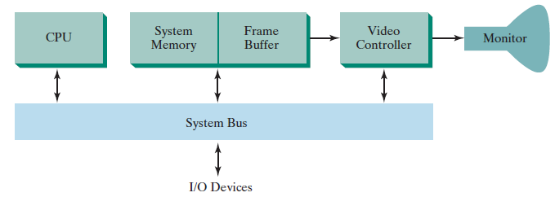
Raster-Scan Systems
Raster system with fixed portion of main memory reserved for the frame buffer.

Slide 17
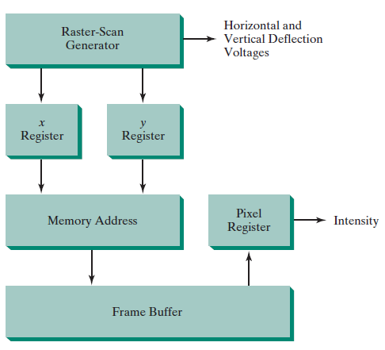
Raster-Scan Systems
Video controller

Slide 18
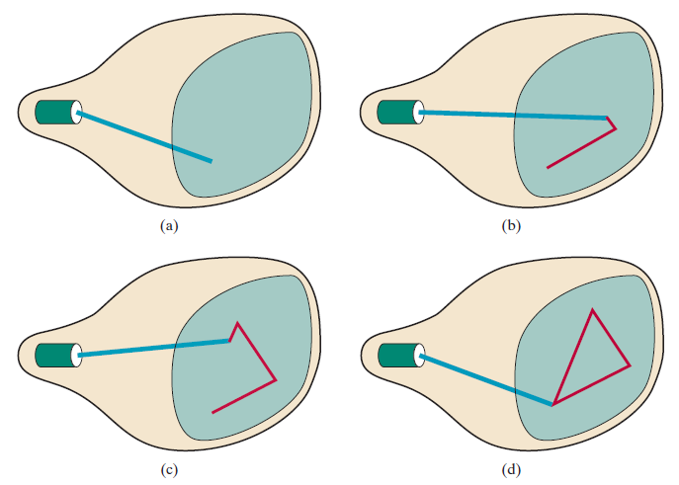
Random-Scan Display
Also called Vector-scan display
Pictures are generated as line drawings
Requires little memory (refresh buffer)
limited to simple, line-based images

Slide 19
Flat-Panel Display
A class of video devices that have reduced volume, weight and power
Two categories:
Emissive displays: convert electrical energy to light (e.g. Plasma panels and Light-emitting diode (LED))
Nonemissive displays: use optical effect to convert light from a certain source into graphics patterns (e.g. Liquid-crystal display (LCD))

Slide 20
LED
A matrix of diodes are arranged to form a pixel position in a display
As in CRT the picture information is stored in a frame buffer
The information is read from the frame buffer and converted to voltage level applied to the diodes to produce the light pattern in the display

Slide 21
LCD
Used in small systems such as : laptops and calculators
The picture is produced by passing polarized light from an internal source through a liquid crystal material

Slide 22
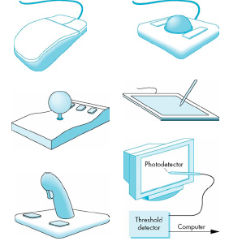
Input Devices
Input devices include
Pointing/locator devices:
indicate location on screen
– Mouse/trackball/spaceball
– Joystick
– Touch pad and touch screen
Keyboard device: send character input
Choice devices: mouse buttons, function keys

Slide 23
Computer Graphics Software
OpenGL

Slide 24
Graphics Software
Graphics software
Special purpose
For non programmers
CAD, CAM, painting, animation (Maya)
General programming packages
Library of graphics functions
C, C++, Java, …
Graphics Library (GL), OpenGL
Virtual Reality Modeling Language (VRML),

Slide 25
OpenGL
OpenGL (Open Graphics Library) is a standard specification defining a cross-language cross-platform API (Application Programming Interface) for writing applications that produce 2D and 3D computer graphics.
The interface consists of over 250 different function calls which can be used to draw complex three-dimensional scenes from simple primitives.
OpenGL is widely used in CAD, virtual reality, scientific visualization, information visualization, and flight simulation. It is also used in video games

Slide 26
OpenGL
It consists of three main libraries:
GL (Graphics Library) - basic OpenGL functions
GLU (Graphics Utility Library) - it uses only GL functions to provide routines for sitting up viewing and projection matrices, describing complex object, such as spheres, that users prefer not to write repeatedly
GLUT (Graphics Library Utility Toolkit) – handle the window managing operation
Notes:
GLU consists of a number of functions that use the base OpenGL library to provide higher-level drawing routines from the more primitive routines that OpenGL provides. It is usually distributed with the base OpenGL package.
(GLU functions can be easily recognized by looking at them because they all have glu as a prefix )
library of utilities for OpenGL programs, which primarily perform system-level I/O with the host operating system. Functions performed include window definition, window control, and monitoring of keyboard and mouse input.
the X Window System (commonly X11 or X) is a windowing system that implements the X display protocol and provides windowing on bitmap displays.

Slide 27
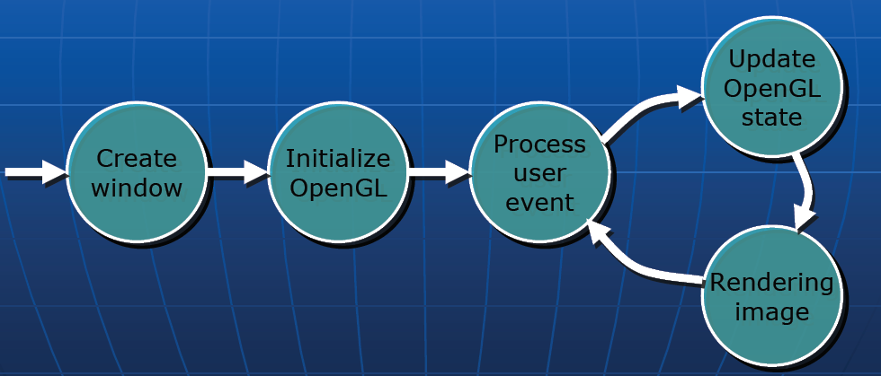
OpenGL

Slide 28
OpenGL
OpenGL functions (which are called commands) are designed to provide 2D and 3D graphics with the emphasis on 3D. The program is fully functional, including everything that users usually want out of 3D graphics. This includes:
3D transformations: Rotation, Scaling, Translation, Perspective
Color models: R, G, B, Alpha (blending parameter)
Rendering: Texture mapping
Modeling: Curves, surfaces….
Interaction
... and others

Slide 29
Graphics functions --8 classes
Geometric primitive functions (output functions)
attribute functions
viewing and transformation functions
input functions
control functions
inquiry functions
segmentation functions
meta-file functions

Slide 30
1) Geometric primitive functions
graphical primitives -→ display
Primitives:
Vertex
Line
Polygon
Cylinder
Sphere
Cone
……………………

Slide 31
OpenGL Geometric Primitives
All geometric primitives are specified by vertices
GL_LINES
GL_POLYGON
GL_POINTS
GL_LINE_STRIP
GL_LINE_LOOP
GL_TRIANGLES
GL_QUADS
GL_QUAD_STRIP
GL_TRIANGLE_STRIP
GL_TRIANGLE_FAN
Notes:
Every OpenGL geometric primitive is specified by its vertices

Slide 32
2) attribute functions
To determine how the primitives are to be displayed.
attributes–
Color
Thickness
Font
………….

Slide 33
3) viewing & transformation functions
To specify the viewing parameters.
viewing parameters
Window
Viewport
clipping functions
World coordinate (WC) → NDC (Normalized Device Coord)
NDC → Device coordinate (DC)
geometric transformations within WC and NDC

Slide 34
4,5) input &control functions
Input:
handles the logical input devices.
Control
To control displays, input devices, system states,…•e.g., close, open, resolution setting, mode setting, ...

Slide 35
6) inquiry functions
To find out the properties or the internal states of the graphics system.
States?
current color, projection transformation, material properties etc.

Slide 36
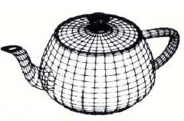
7,8) segmentation & meta-file functions
To allow users to form and manipulate identifiable groups of primitives.
segment, structure
Meta-file: To save and load graphics files
e.g., VRML

Slide 37
OpenGL Command Syntax
OpenGL function names start with the letters gl, glu or glut
OpenGL defined constants start with the letters GL, GLU or GLUT
OpenGL function names have the following format:
gl<Command>[234][sifd][v](args ...)
Example: glVertex2f(), glVertex3f(), glVertex3fv()

Slide 38
OpenGL Command Syntax (Concluded)
glVertex3fv( v )
Number of
components
Data Type
Vector
b - byte
ub - unsigned byte
s - short
us - unsigned short
i - int
ui - unsigned int
f - float
d - double
omit “v” for
scalar form
glVertex2f( x, y )
2 - (x,y)
3 - (x,y,z)
4 - (x,y,z,w)

Slide 39
OpenGL Example
glClear (GL_COLOR_BUFFER_BIT) // apply clear color to color buffer
glBegin(GL_TRIANGLES); // Drawing Using Triangles
glColor3f(1.0f, 0.0f, 0.0f); // set color to red
glVertex2i( 100, 150); // top
glColor3f(0.0f, 1.0f, 0.0f); // set color to green
glVertex2i(10,10); // bottom Left
glColor3f(0.0f, 0.0f, 1.0f); // set color to blue
glVertex2i(180,15); // bottom right
glEnd(); // finished drawing the triangle

Slide 40
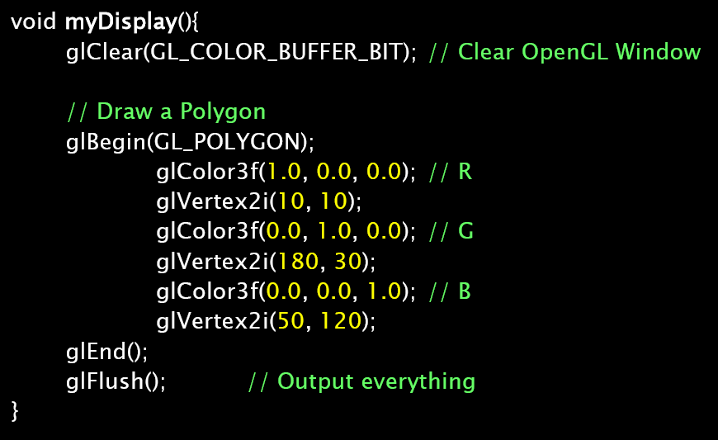
Example

Slide 41
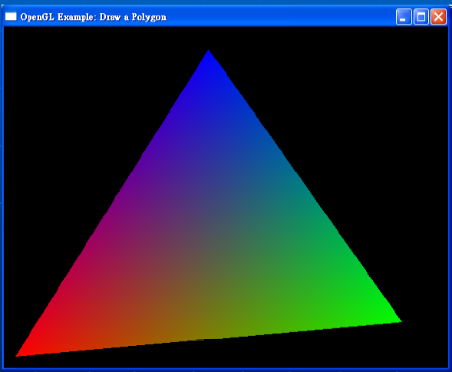
Example

Slide 42
Complete Program
#include<windows.h>
#include<GL\glut.h>
#include<GL\gl.h>
void init (void)
{
glClearColor(1.0,1.0,1.0,0.0); //specifies clear values for the color buffers (R,G,B,Alpha)
glMatrixMode(GL_PROJECTION); // sets the current matrix mode
gluOrtho2D(0.0,200.0,0.0,150.0); //2D orthographic projection matrix (left,right,bottom,top)
}

Slide 43
Complete Program
void linesegment (void)
{
glClear(GL_COLOR_BUFFER_BIT);
glColor3f(1.0,0.0,0.0);
glBegin(GL_LINES);
glVertex2i(180,15);
glVertex2i(10,145);
glEnd();
glFlush();
}

Slide 44
Complete Program
void main (int argc, char** argv)
{
glutInit(&argc,argv);
glutInitDisplayMode(GLUT_SINGLE | GLUT_RGB); //sets the initial display mode
glutInitWindowPosition(50,100); //sets the initial window position
glutInitWindowSize(400,300); //sets the initial window size
glutCreateWindow("Line"); // creates the window with name line
init();
glutDisplayFunc(linesegment); //sets the display callback for the current window.
glutMainLoop(); // enters the GLUT event processing loop
}

